Slide 1
Real time systems
Pravin Y Pawar

Slide 2
Responding in Real Time
Few Examples
World is now operating more and more in the now
Ability to process data as it arrives (processing data in the present)
Your twitter friend / celebrity posts a tweet, and you see it almost immediately…
You are tracking flights around New Delhi Live…
You are using the nseindia.com tracker page to track your favourite stocks…

Slide 3
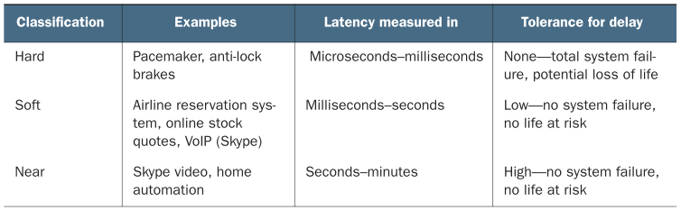
Classification of Real Time Systems
Source : Streaming Data by Andrew Psaltis

Slide 4
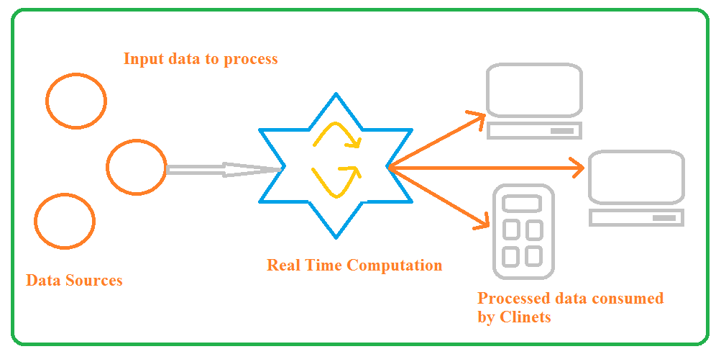
A generic real-time system with consumers
Consumers are connected to the service online
Source : Adapted from Streaming Data by Andrew Psaltis

Slide 5
A generic real-time system with consumers(2)
Examples discussion
In each of the examples, is it reasonable to conclude that
the time delay may only last for seconds?
no life is at risk?
an occasional delay for minutes would not cause total system failure?

Slide 6
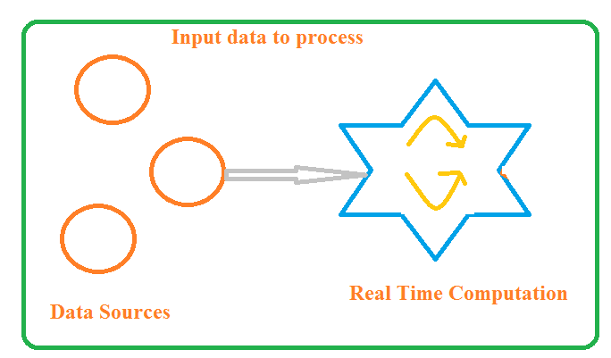
A generic real-time system without consumers
Consumers are not connected to the service but service continues its operation
Source : Adapted from Streaming Data by Andrew Psaltis

Slide 7
A generic real-time system without consumers(2)
Examples discussion
A tweet is posed on twitter
The Live Flight Tracking service tracking flights
Real time quotes monitoring application is tracking the stock quotes
Does focusing on the data processing and taking consumers of the data out of picture change your answer?
Difference between soft real time and near real time becoming blurry
Together they are just termed as real time

Slide 8
Thank You!
In our next session: Difference between Batch Processing and Stream Processing

